Slide 1
SECURE DATA HIDING IN IMAGES USING STEGANOGRAPHY
CAPSTONE PROJECT
Presented By :Rangu Akshay
Student Name : Rangu Akshay
College Name & Department :SR University & CSE

Slide 2
OUTLINE
Problem Statement
Technology used
Wow factor
End users
Result
Conclusion
Git-hub Link
Future scope

Slide 3
Problem Statement
With the increasing need for secure communication, traditional encryption methods alone are not always sufficient to protect sensitive information from cyber threats and unauthorized access. Steganography provides an additional layer of security by concealing data within digital images, making it less likely to be detected. However, challenges such as maintaining image quality, preventing detection by steganalysis tools, and ensuring efficient data embedding need to be addressed. This project aims to develop a secure and effective steganographic method for hiding data in images while minimizing distortion and maximizing security.

Slide 4
Technology used
Technology Used
For implementing secure data hiding in images using steganography, the following technologies were used:
Programming Language: Python – for encoding and decoding hidden messages.
Steganography Technique: Least Significant Bit (LSB) substitution – to embed data into image pixels.
Libraries:
OpenCV – for image processing.
NumPy – for handling image arrays efficiently.
PIL (Pillow) – for image manipulation.
Graphical User Interface (GUI) (if applicable): Tkinter or PyQt for user interaction.
Encryption (Optional): AES or RSA for enhancing security before embedding data.

Slide 5
Wow factors
High Security: Uses steganography and optional encryption for enhanced data protection.
Undetectable Changes: Hidden data does not visibly alter the image, making detection difficult.
User-Friendly Interface: A simple and intuitive GUI for easy data hiding and extraction.
Multiple File Support: Can embed different types of files (text, images, or even small documents).
Lightweight & Fast: Efficient algorithms ensure quick processing with minimal storage impact.
Real-World Applications: Useful for secure communication, watermarking, and digital rights management.

Slide 6
End users
End users are the final consumers or individuals who use a product, service, or system. In the context of your steganography project, the end users could include:
Cybersecurity Professionals – Use steganography for secure communication and data protection.
Journalists & Whistleblowers – Hide sensitive information to avoid detection.
Government & Military – Secure classified information transmission.
Businesses & Organizations – Protect confidential corporate data.
Individuals & Privacy Enthusiasts – Safeguard personal data from cyber threats.
Digital Forensics Experts – Detect and analyze hidden data in digital investigations.

Slide 7
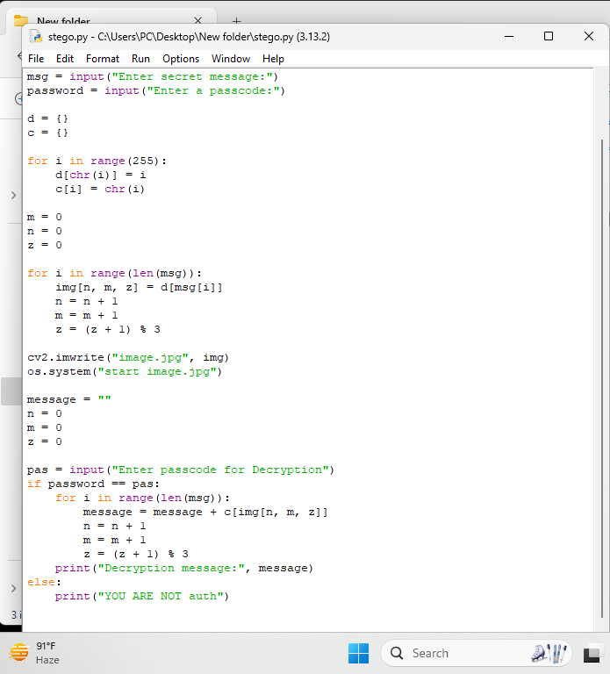
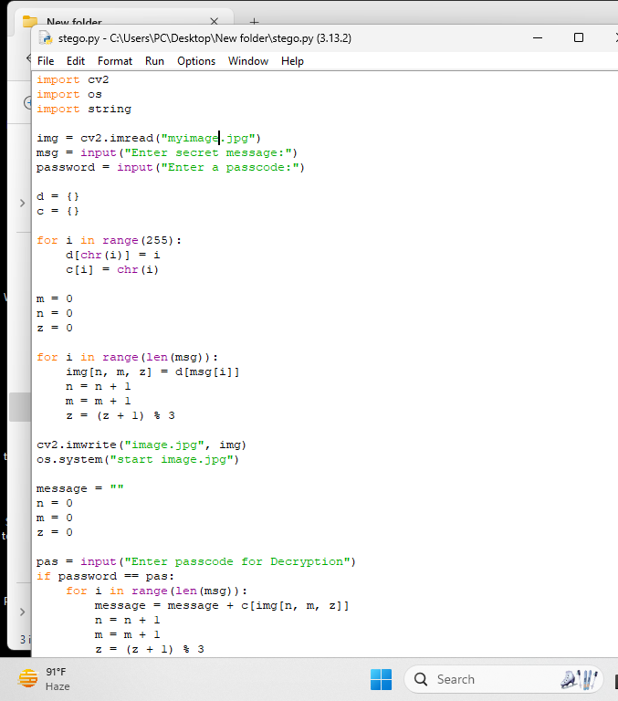
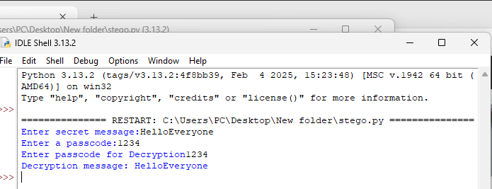
Results

Slide 8
Conclusion
Steganography is an effective technique for securely hiding data within images while maintaining their visual integrity. This project implemented and analyzed methods like Least Significant Bit (LSB) substitution for covert data embedding. The results showed that hidden information remains undetectable to the human eye, making it useful for secure communication. However, it has limitations, such as vulnerability to steganalysis techniques. Future improvements can focus on more advanced embedding methods and encryption integration. Overall, steganography is a valuable tool for enhancing data security and confidentiality.

Slide 9
GitHub Link
https://github.com/Akshay-tach/AICTE-project-2025/tree/main

Slide 10
Future scope(optional)
Enhanced Security: Implement advanced encryption techniques along with steganography for better protection.
Adaptive Steganography: Develop intelligent algorithms that adjust embedding techniques based on image characteristics.
Audio & Video Steganography: Extend the method to hide data in audio and video files for broader applications.
Steganalysis Resistance: Improve methods to prevent detection by advanced steganalysis tools.
Cloud Integration: Implement a cloud-based steganographic system for secure online data storage and sharing.
AI & Machine Learning: Use AI to optimize data hiding and extraction processes for efficiency and security.

Slide 11
THANK YOU

